Slide 1


+
Tips to help make filing your taxes ez!

Slide 2
Getting Started!
Agenda
Website Review
Important Info For Student Athletes
Q and A
1

Slide 3
Getting Started!
Quick Reference
1. Start filing your taxes at www.eztaxreturn.com/sunbelt
2. You get access to:
  The ezTaxReturn DIY (Do it yourself) online tax filing application.
  Dedicated support representatives.
  Simple step-by-step videos.
  Links to FAQ's and tax articles.
3. Ask questions using
student.athlete@eztaxreturn.com
2

Slide 4
Important Dates/Info!
Quick Reference
You should have received W-2’s and 1099’s from the payers (employer or company who paid you) by February 2nd.
Taxes are due by April 15th, 2026.
Check your refund status here: https://www.irs.gov/wheres-my-refund
3

Slide 5
Do You
Need to
File?
Determining if You Need to File a Federal Return
The IRS requires that you file a federal tax return if your income (for a Single person) is $15,750 or more for tax year 2025. While you may not be technically required to file a federal tax return because your income was less than this, if you had federal and/or state taxes withheld from your pay (i.e., taxes paid through payroll), you can receive a refund of the taxes you paid by filing a tax return. You can always search here for the federal filing requirements as they change annually - Check if you need to file a tax return | Internal Revenue Service.
Attention gig workers (like Uber or DoorDash drivers)! You are likely considered to be self-employed, for tax purposes. If you earned income through self-employment, you are required to file a federal tax return if you have over $400 in net earnings (total earnings minus expenses).
4

Slide 6
Do You
Need to
File State?
Determining if You Need to File a State Return
State tax filing requirements often differ from federal filing requirements. Even if you are not required to file a federal tax return (because you made less than $15,750 in wages or less than $400 in self-employment income), you may be required to file a state tax return.
The next page has links to your state tax filing requirements.
5

Slide 7
State Links
Tax Filing Requirements For Each State
Alabama - https://www.revenue.alabama.gov/faqs/who-must-file-an-alabama-individual-income-tax-return/
Arkansas - https://www.dfa.arkansas.gov/office/taxes/income-tax-administration/individual-income-tax/faqs/
Georgia - https://dor.georgia.gov/residency-filing-requirements
Louisiana - https://revenue.louisiana.gov/individuals/general-resources/individual-income-tax/?utm_source=openai
Mississippi - https://www.dor.ms.gov/individuals/individual-income-tax
North Carolina - https://www.ncdor.gov/taxes-forms/individual-income-tax
South Carolina - https://dor.sc.gov/tax/individual-income
Texas – No personal income tax!
Virginia - https://www.tax.virginia.gov/individual-income-tax
West Virginia - https://tax.wv.gov/Individuals/Pages/Individuals.aspx
6

Slide 8
Personal Information
When entering your personal information on your tax return, keep the following in mind:
Use your full legal name (i.e., Joseph instead of Joe).
If you use a middle initial in your legal signature, include it on your tax return.
If your legal name has a suffix (like Jr or III), include it on your tax return.
Double-check your entries (you would be surprised by how many people enter their birthdate or Social Security Number incorrectly).
7

Slide 9
Your Home Address
Entering the right address!
If you live in a dorm or in an apartment near campus, but you go home to your parents during summer and other breaks, your home address on your tax return is probably your parents’ address (considered your permanent/legal address). This is applicable even if you have a tax document (like a W-2) with your school address on it.
For example, if you are now attending college in Arkansas but your parents live in New York, your home address on your tax return would be your parents' address in New York.
If you are now attending college in West Virginia and your parents live in West Virginia, your home address on your tax return would be your parents' address in West Virginia.
8

Slide 10
Dependency
Status
Selecting the Correct Dependency Status
Dependent of Another
When you file a tax return, you will need to know/understand if you are a dependent of another or not.
As a college student, if you are financially dependent on your parents, you are probably considered their dependent. Ask them before you file your taxes!
Certain deductions/credits are not available if you are a dependent of another, as they are intended for the taxpayer who provides financial support.
When preparing your tax return, you will be asked if you are a dependent of another. If you are a dependent of your parents and you do not indicate so on your tax return, you will cause a lot of headaches for both yourself and your parents when they go to file their tax returns.
Not a Dependent of Another
If you are financially independent, you are likely not a dependent of another and can therefore potentially be eligible for certain credits or deductions.
9

Slide 11
Entering Income
Entering Income
Generally, you will receive a tax document for income that needs to be reported on your tax return. The most common document entered on tax returns is a W-2 form, which reports your wages as an employee. Other common income types of college-age taxpayers are listed here:
1099-INT (interest income, if you have a bank account)
1099-K (gig economy, like Uber or DoorDash drivers)
1099-MISC (royalty income, or compensation received for use of your Name, Image or Likeness – without having to promote it)
1099-NEC (self-employment/NIL income (similar to royalty except that compensation requires promotion)
The most important thing to remember when entering these documents into your tax return is be sure to copy the information into your tax return exactly as it appears on the document you received. And double-check your entries!
10

Slide 12
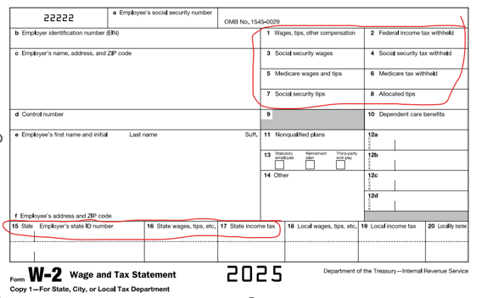
W-2
Form
What a W-2 Form Looks Like
11

Slide 13
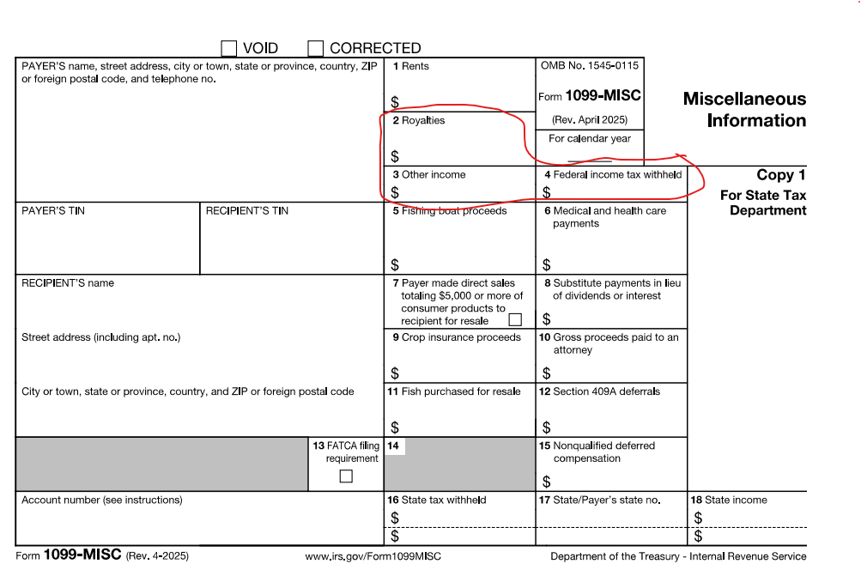
1099-MISC Form
What a 1099-MISC Form Looks Like
12

Slide 14
Scholarship Income
Is your scholarship income taxable?
If you received a scholarship for tuition only, this is not considered taxable income. It still needs to be reported on your tax return though.
The taxable portion of a scholarship or fellowship grant is generally the amount used for non-tuition expenses (such as room, board, and travel).
13

Slide 15
NIL/Royalty Income
Reporting Name, Image, or Likeness (NIL) Income and Royalty Income
NIL Income
NIL income is compensation, both cash and non-cash (merchandise, gift cards, cars, crypto), earned by student-athletes for the use of their Name, Image, and Likeness (NIL). NIL income requires you to actively promote something to receive your compensation.
NIL income is generally considered self-employment income, requiring self-employment taxes to be paid on NIL income received.
Royalty Income
Royalties are "passive payments" for licensing your image (like video games) which are also taxable (but taxed as regular income and not as self-employment). This means you received compensation for the use of your Name, Image, and Likeness but does not require you to actively promote anything.
14

Slide 16
Education Credits
Claiming Education Credits
Dependent of Another?
If you determined that you are a dependent of your parents, you cannot claim education credits for tuition paid, but your parents can.
Not a Dependent of Another?
If you are not a dependent of another and you paid for your own tuition, fees, books (not through scholarship) and support, you may be able to claim education credits for expenses paid by you.
The Lifetime Learning Credit is non-refundable. This means the credit reduces your tax (up to $2,000). For example – you earned $20,000 and your tax ends up being $423, your tax would be reduced to $0 but you would not be refunded the difference.
The American Opportunity Tax Credit is a partially refundable credit. If you earned $20,000 and you tax ends up being $423, your tax would be reduced to $0 and you would receive a $1,000 refund.
*Note - students under age 24 usually only qualify for this refund if their earned income (from a job) provides more than half of their own financial support.
15

Slide 17
State Taxes
Filing Your State Tax Return
Filing your state tax return is easy, as most of the information is carried over from your federal tax return to the state tax return.
Questions asked in the state program are typically state-specific and are for additional deductions or credits offered only at the state level.
If your home state is the same state where you worked, you will file a state tax return for that state only. If your home state is different than the state you went to school and worked in, you may need to file a state return for both states (but you generally do not pay tax in both states).
16

Slide 18
Looking for
Help
“Learning about taxes when you are young is one of the smartest investments you can make in yourself. It gives you the power to take charge of your financial health — without having to depend on anyone else.”
Utilize the Help Available
Even though tax law can feel overwhelming and complex, filing your taxes doesn’t have to be stressful or confusing.
There should always be links to immediate help for quick explanations that can answer lots of questions for you.
There should always be a way to easily ask for more help if needed (like your dedicated email support).
17

Slide 19
Q and A
Do you have any questions we
have not answered?
18

